Slide 1
Distributed Systems Course
Operating System Support
Chapter 6:
6.1 Introduction
6.2 The operating system layer
6.4 Processes and threads
6.5 Communication and invocation
6.6 operating system architecture
VFSTR

Slide 2
Learning objectives
Know what a modern operating system does to support distributed applications and middleware
  Definition of network OS
  Definition of distributed OS
Understand the relevant abstractions and techniques, focussing on:
  processes, threads, ports and support for invocation mechanisms.
Understand the options for operating system architecture
  monolithic and micro-kernels
If time:
  Lightweight RPC
VFSTR
*

Slide 3
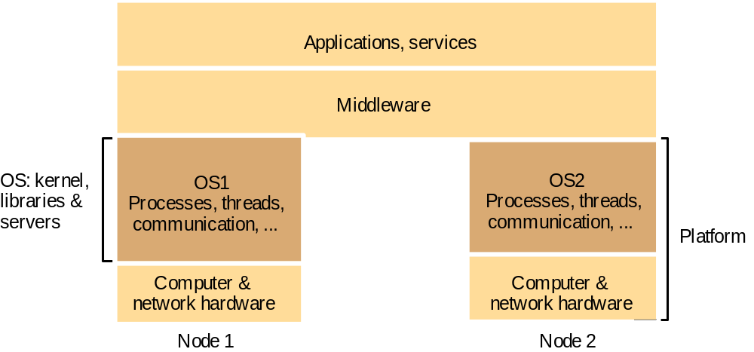
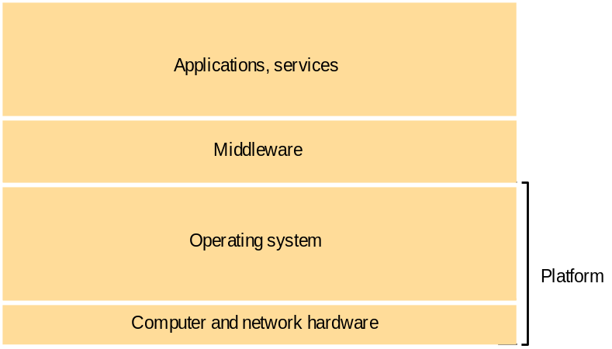
System layers
Figure 6.1
Figure 2.1
Software and hardware service layers in distributed systems
VFSTR
*
Notes:
Popup: System layers figure from Chapter 2

Slide 4
Middleware and the Operating System
Middleware implements abstractions that support network-wide programming. Examples:
    RPC and RMI (Sun RPC, Corba, Java RMI)
    event distribution and filtering (Corba Event Notification, Elvin)
    resource discovery for mobile and ubiquitous computing
    support for multimedia streaming
Traditional OS's (e.g. early Unix, Windows 3.0)
  simplify, protect and optimize the use of local resources
Network OS's (e.g. Mach, modern UNIX, Windows NT)
  do the same but they also support a wide range of communication standards and enable remote processes to access (some) local resources (e.g. files).
What is a distributed OS?
  Presents users (and applications) with an integrated computing platform that hides the individual computers.
  Has control over all of the nodes (computers) in the network and allocates their resources to tasks without user involvement.
    In a distributed OS, the user doesn't know (or care) where his programs are running.
  Examples:
    Cluster computer systems
    V system, Sprite, Globe OS
    WebOS (?)
VFSTR
*

Slide 5
The support required by middleware and distributed applications
OS manages the basic resources of computer systems:
  processing, memory, persistent storage and communication.
It is the task of an operating system to:
  raise the programming interface for these resources to a more useful level:
    By providing abstractions of the basic resources such as:
    processes, unlimited virtual memory, files, communication channels
    Protection of the resources used by applications
    Concurrent processing to enable applications to complete their work with minimum interference from other applications
  provide the resources needed for (distributed) services and applications to complete their task:
    Communication - network access provided
    Processing - processors scheduled at the relevant computers
VFSTR
*

Slide 6
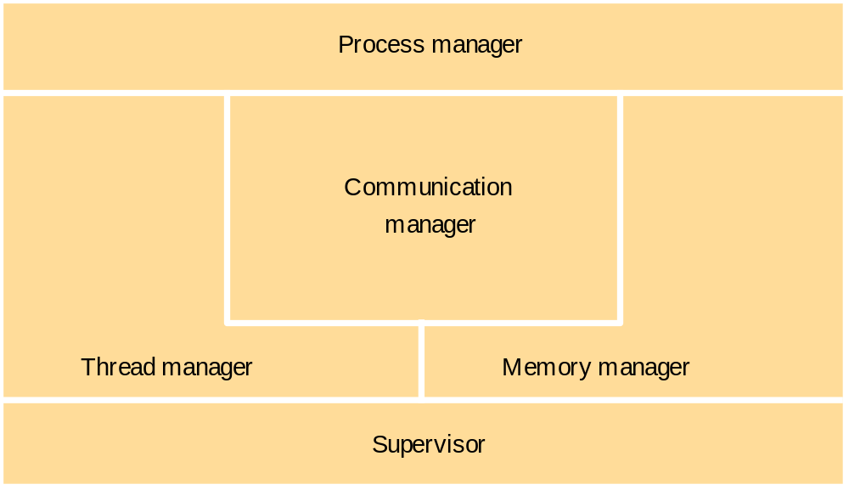
Core OS functionality
Figure 6.2
VFSTR
*

Slide 7
Process address space
Figure 6.3
N
Regions can be shared
  kernel code
  libraries
  shared data & communication
  copy-on-write
Files can be mapped
  Mach, some versions of UNIX
UNIX fork() is expensive
  must copy process's address space
2
Auxiliary
regions
Stack
Heap
Text
0
VFSTR
*

Slide 8
Copy-on-write – a convenient optimization
Figure 6.4
Process A’s address space
Process B’s address space
RB copied
from RA
RA
RB
Kernel
Shared
frame
A's page
B's page
table
table
a) Before write
b) After write
VFSTR
*

Slide 9
Threads concept and implementation
Process
Thread activations
Activation stacks
(parameters, local variables)
Heap (dynamic storage,
objects, global variables)
'text' (program code)
system-provided resources
(sockets, windows, open files)
VFSTR
*
Notes:
Question: what represents the activation of each thread? Answer: See Figure 6.7 for full details, but essentially: the current instruction pointer and other registers and a pointer to its activation stack.
Box on p. 215:
An analogy for threads and processes
The following memorable, if slightly unsavoury, way to think of the concepts of threads and execution environments was seen on the comp.os.mach USENET group and is due to Chris Lloyd. An execution environment consists of a stoppered jar and the air and food within it. Initially, there is one fly – a thread – in the jar. This fly can produce other flies and kill them, as can its progeny. Any fly can consume any resource (air or food) in the jar. Flies can be programmed to queue up in an orderly manner to consume resources. If they lack this discipline, they might bump into one another within the jar – that is, collide and produce unpredictable results when attempting to consume the same resources in an unconstrained manner. Flies can communicate with (send messages to) flies in other jars, but none may escape from the jar, and no fly from outside may enter it. In this view, a standard UNIX process is a single jar with a single sterile fly within it.

Slide 10
Client and server with threads
Figure 6.5
Thread 2 makes
Receipt &
Input-output
requests to server
queuing
Thread 1
generates
results
Requests
N threads
Client
Server
The 'worker pool' architecture
See Figure 4.6 for an example of this architecture programmed in Java.
VFSTR
*
Notes:
Describes a typical architecture for the use of threads - the 'worker pool' architecture. Server spawns a thread to handle each incoming request. Concurrency of threads enables several disk requests to be performed concurrently (on different disks, or on a single disk with a disk driver that re-orders the requests for optimum head movement (elevatror algorithm)).
Client uses threads to enable processing to proceed while waiting for return of remote invocations.

Slide 11
Alternative server threading architectures
Figure 6.6
server
process
server
process
server
process
workers
per-connection threads
per-object threads
I/O
remote
remote
I/O
remote
objects
objects
objects
a. Thread-per-request
b. Thread-per-connection
c. Thread-per-object
  Implemented by the server-side ORB in CORBA
  would be useful for UDP-based service, e.g. NTP
  is the most commonly used - matches the TCP connection model
  is used where the service is encapsulated as an object. E.g. could have multiple shared whiteboards with one thread each. Each object has only one thread, avoiding the need for thread synchronization within objects.
VFSTR
*

Slide 12
Threads versus multiple processes
Creating a thread is (much) cheaper than a process (~10-20 times)
Switching to a different thread in same process is (much) cheaper (5-50 times)
Threads within same process can share data and other resources more conveniently and efficiently (without copying or messages)
Threads within a process are not protected from each other
Figure 6.7 State associated with execution environments and threads
Execution environment
Thread
Address space tables
Saved processor registers
Communication interfaces, open files
Priority and execution state (such as
BLOCKED
)
Semaphores, other synchronization
Software interrupt handling information
objects
List of thread identifiers
Execution environment identifier
VFSTR
Pages of address space resident in memory; hardware cache entries
*
Notes:
Hidden

Slide 13
Java thread constructor and management methods
Figure 6.8
Methods of objects that inherit from class Thread
Thread(ThreadGroup group, Runnable target, String name)
  Creates a new thread in the SUSPENDED state, which will belong to group and be identified as name; the thread will execute the run() method of target.
setPriority(int newPriority), getPriority()
  Set and return the thread’s priority.
run()
  A thread executes the run() method of its target object, if it has one, and otherwise its own run() method (Thread implements Runnable).
start()
  Change the state of the thread from SUSPENDED to RUNNABLE.
sleep(int millisecs)
  Cause the thread to enter the SUSPENDED state for the specified time.
yield()
  Enter the READY state and invoke the scheduler.
destroy()
  Destroy the thread.
VFSTR
*
Notes:
Animation: a red box outlines each method in turn

Slide 14
Java thread synchronization calls
Figure 6.9
See Figure 12.17 for an example of the use of object.wait() and object.notifyall() in a transaction implementation with locks.
thread.join(int millisecs)
  Blocks the calling thread for up to the specified time until thread has terminated.
thread.interrupt()
  Interrupts thread: causes it to return from a blocking method call such as sleep().
object.wait(long millisecs, int nanosecs)
  Blocks the calling thread until a call made to notify() or notifyAll() on object wakes the thread, or the thread is interrupted, or the specified time has elapsed.
object.notify(), object.notifyAll()
  Wakes, respectively, one or all of any threads that have called wait() on object.
Receipt &
Input-output
queuing
Requests
N threads
Server
object.wait() and object.notify() are very similar to the semaphore operations. E.g. a worker thread in Figure 6.5 would use queue.wait() to wait for incoming requests.
synchronized methods (and code blocks) implement the monitor abstraction. The operations within a synchronized method are performed atomically with respect to other synchronized methods of the same object. synchronized should be used for any methods that update the state of an object in a threaded environment.
VFSTR
*

Slide 15
Threads implementation
Threads can be implemented:
  in the OS kernel (Win NT, Solaris, Mach)
  at user level (e.g. by a thread library: C threads, pthreads), or in the language (Ada, Java).
    + lightweight - no system calls
    + modifiable scheduler
    + low cost enables more threads to be employed
    not pre-emptive
    can exploit multiple processors
    - page fault blocks all threads
  Java can be implemented either way
  hybrid approaches can gain some advantages of both
    user-level hints to kernel scheduler
    heirarchic threads (Solaris)
    event-based (SPIN, FastThreads)
VFSTR
*

Slide 16
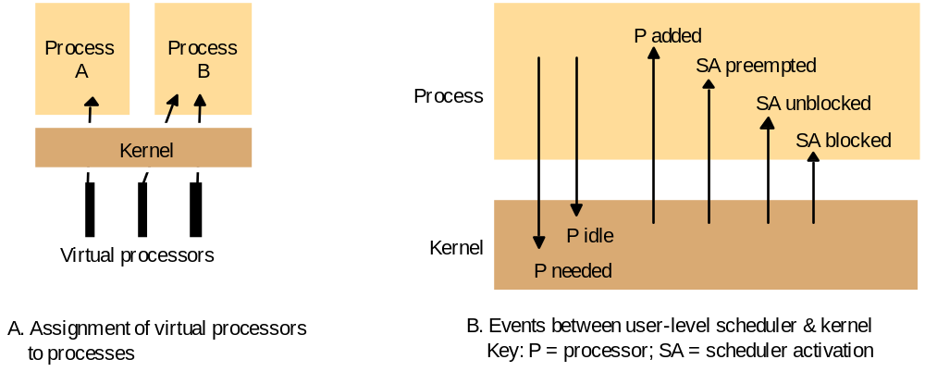
Scheduler activations
Figure 6.10
VFSTR
*
Notes:
Hidden

Slide 17
Support for communication and invocation
The performance of RPC and RMI mechanisms is critical for effective distributed systems.
  Typical times for 'null procedure call':
  Local procedure call < 1 microseconds
  Remote procedure call ~ 10 milliseconds
  'network time' (involving about 100 bytes transferred, at 100 megabits/sec.) accounts for only .01 millisecond; the remaining delays must be in OS and middleware - latency, not communication time.
Factors affecting RPC/RMI performance
  marshalling/unmarshalling + operation despatch at the server
  data copying:- application -> kernel space -> communication buffers
  thread scheduling and context switching:- including kernel entry
  protocol processing:- for each protocol layer
  network access delays:- connection setup, network latency
10,000 times slower!
VFSTR
*

Slide 18
Implementation of invocation mechanisms
Most invocation middleware (Corba, Java RMI, HTTP) is implemented over TCP
  For universal availability, unlimited message size and reliable transfer; see section 4.4 for further discussion of the reasons.
  Sun RPC (used in NFS) is implemented over both UDP and TCP and generally works faster over UDP
Research-based systems have implemented much more efficient invocation protocols, E.g.
  Firefly RPC (see www.cdk3.net/oss)
  Amoeba's doOperation, getRequest, sendReply primitives (www.cdk3.net/oss)
  LRPC [Bershad et. al. 1990], described on pp. 237-9)..
Concurrent and asynchronous invocations
  middleware or application doesn't block waiting for reply to each invocation
VFSTR
*

Slide 19
Invocations between address spaces
Figure 6.11
(a) System call
Thread
Control transfer via
trap instruction
Control transfer via
privileged instructions
User
Kernel
Protection domain
(b) RPC/RMI (within one computer)
boundary
Thread 1
Thread 2
User 1
Kernel
User 2
(c) RPC/RMI (between computers)
Thread 1
Network
Thread 2
VFSTR
User 1
User 2
Kernel 1
Kernel 2
*

Slide 20
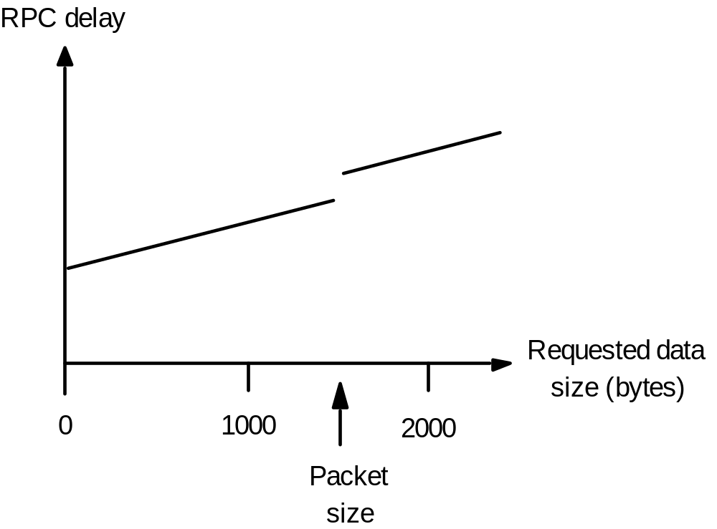
RPC delay against parameter size
Figure 6.12
VFSTR
*
Notes:
Hidden

Slide 21
Bershad's LRPC
Uses shared memory for interprocess communication
  while maintaining protection of the two processes
  arguments copied only once (versus four times for convenitional RPC)
Client threads can execute server code
  via protected entry points only (uses capabilities)
Up to 3 x faster for local invocations
VFSTR

Slide 22
A lightweight remote procedure call
Figure 6.13
Client
Server
A stack
A
1. Copy args
4. Execute procedure
and copy results
User
stub
stub
Kernel
2. Trap to Kernel
3. Upcall
5. Return (trap)
VFSTR
*
Notes:
Hidden - next slide is an animated version of this figure.

Slide 23
A lightweight remote procedure call
Figure 6.13
Client
Server
A stack
A
1. Copy args
4. Execute procedure and copy results
User
stub
stub
Kernel
2. Trap to Kernel
3. Upcall
5. Return (trap)
VFSTR
*

Slide 24
Times for serialized and concurrent invocations
Figure 6.14
Serialised invocations
Concurrent invocations
process args
process args
marshal
marshal
Send
transmission
Send
process args
marshal
Receive
Send
Receive
unmarshal
unmarshal
execute request
execute request
marshal
marshal
Send
Send
Receive
unmarshal
Receive
Receive
execute request
unmarshal
unmarshal
marshal
process results
process results
Send
process args
marshal
Receive
Send
unmarshal
process results
Receive
time
unmarshal
execute request
marshal
Send
Receive
unmarshal
process results
VFSTR
Client
Server
Client
Server
*
Notes:
Hidden

Slide 25
Monolithic kernel and microkernel
Figure 6.15
S4
.......
S1
S2
S3
S4
.......
S1
S2
S3
.......
Kernel
Kernel
Monolithic Kernel
Microkernel
Figure 6.16
Middleware
Language
Language
OS emulation
support
support
subsystem
subsystem
subsystem
....
Microkernel
Hardware
VFSTR
The microkernel supports middleware via subsystems
*

Slide 26
Advantages and disadvantages of microkernel
+ flexibility and extensibility
  • services can be added, modified and debugged
  • small kernel -> fewer bugs
  • protection of services and resources is still maintained
service invocation expensive
  • unless LRPC is used
  • extra system calls by services for access to protected resources
VFSTR

Slide 27
Relevant topics not covered
Protection of OS resources (Section 6.3)
  Control of access to distributed resources is covered in Chapter 7 - Security
Mach OS case study (Chapter 18)
  Halfway to a distributed OS
  The communication model is of particular interest. It includes:
    ports that can migrate betwen computers and processes
    support for RPC
    typed messages
    access control to ports
    open implementation of network communication (drivers outside the kernel)
Thread programming (Section 6.4, and many other sources)
  e.g. Doug Lea's book Concurrent Programming in Java, (Addison Wesley 1996)
VFSTR
*

Slide 28
Summary
The OS provides local support for the implementation of distributed applications and middleware:
  Manages and protects system resources (memory, processing, communication)
  Provides relevant local abstractions:
    files, processes
    threads, communication ports
Middleware provides general-purpose distributed abstractions
  RPC, DSM, event notification, streaming
Invocation performance is important
  it can be optimized, E.g. Firefly RPC, LRPC
Microkernel architecture for flexibility
  The KISS principle ('Keep it simple – stupid!')
    has resulted in migration of many functions out of the OS
VFSTR
*

